Slide 1


Netflix Movies & TV Analysis
Presented By – Suraj Darwalkar

Slide 2

Introduction
This project aims to analyze Netflix TV and Movies data to gain insights into user preferences, content trends, and the impact of user ratings and Top Actor, Top Director ,Genre .

Slide 3
PROBLEM SOLVING METHODOLOGY
Data Sources
Data Cleaning
Data Visualization
Collect data from different source.
Check data entry mistakes.
Briefly summarize the criteria used for each Genre ,TV, Movie selection.
Use proper visualization techniques.
The various data sources utilized at Netflix for analysis (e.g., Genre, Top Actor, Top Director, Rating, Release Year).
Display relevant visualizations, such as Pie Chart, count plots, and Bar plots, for each analysis.
Used exploratory data analysis (EDA) to analyze the dataset and extract insights.

Slide 4
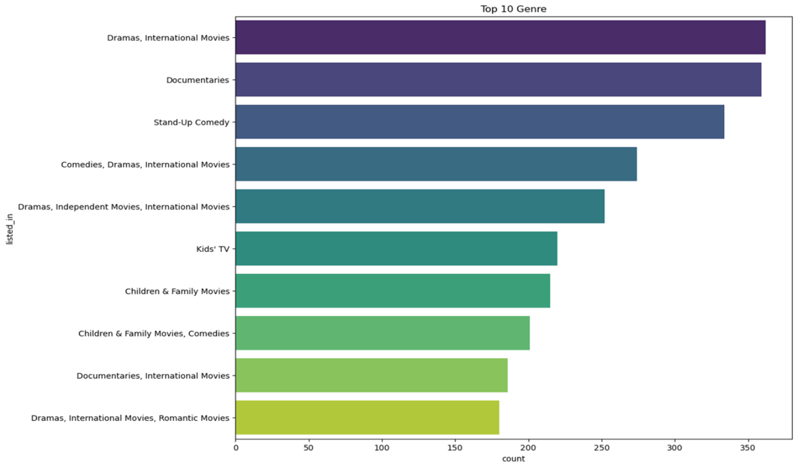
Dramas, International Movies top most Genre Listed_in.these are the most popular Genres on Netflix.
Top 10 Genres in Netflix Content

Slide 5
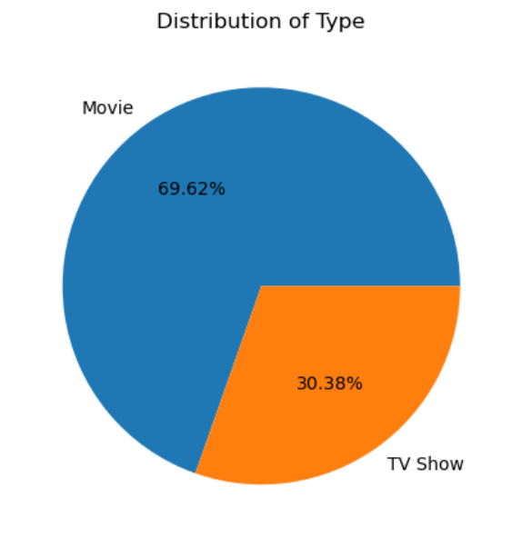
Distribution of Movie has most watch shows as compared to TV Shows.
Type of Most Watched Shows on Netflix
Distribution of Type
Movie Counts 6131
TV Show Counts 2676

Slide 6
Top countries with Most Contributions to Netflix
United States 2818
India 972
United Kingdom 419
Japan 245
South Korea 199
Canada 181
Spain 145
France 124
Mexico 110
Most number of Movies and TV shows are produced by United States Followed by India who has Produced the second most number of movies on Netflix.

Slide 7
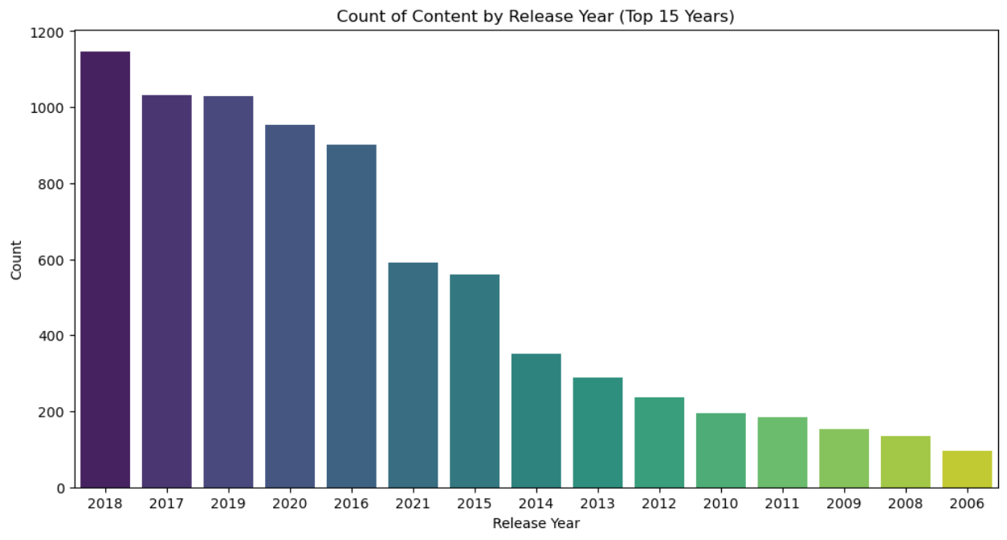
Year wise Count
2018 is the year in which Netflix released alot more content as compared to other year.

Slide 8
Top Most Directors by Number of Titles
Top Most Directors by Number of Titles:
Rajiv Chilaka 19
Raúl Campos 18
Suhas Kadav 16
Marcus Raboy 16
Jay Karas 14
Cathy Garcia-Molina 13
Jay Chapman 12
Youssef Chahine 12
Martin Scorsese 12
Rajiv Chilaka is the top most director has maximum number of titles followed by Raúl Campos .

Slide 9

Conclusion
Netflix has more Movies than TV show.
Most number of Movies and TV shows are produced by United States Followed by India who has Produced the second most number of movies on netflix.
2018 is the year in which Netflix released alot more content as compared to other years.
International Movies and Dramas are the most popular Genres on Netflix.
The rise of streaming services like Netflix, which have made it easier and more affordable for people to access a wide range of content.

Slide 10
Thank You

